Slide 1
Machine Learning DSECL ZG565
Unsupervised Learning
Dr. Monali Mavani
These slides are prepared by the instructor, with grateful acknowledgement of Prof. Tom Mitchell, Prof.. Burges, Prof. Andrew Moore and many others who made their course materials freely available online

Slide 2
Topics to be covered
Ref: Christopher Bishop: Chapter 9
Unsupervised learning
Clustering
K-means Clustering
Gaussian Mixture Models
EM algorithm

Slide 3
Unsupervised Learning
We only use the features X, not the labels Y
This is useful because we may not have any labels but we can still detect patterns
For example:
We can detect that news articles revolve around certain topics, and group them accordingly
Discover a distinct set of objects appear in a given environment, even if we don’t know their names, then ask humans to label each group
Identify health factors that correlate with a disease

Slide 4
What is clustering?
Grouping items that “belong together” (i.e. have similar features)

Slide 5
Feature representation (x)
A vector representing measurable characteristics of a data sample we have
E.g. a glass of juice can be represented via its color = {yellow=1, red=2, green=3, purple=4} and taste = {sweet=1, sour=2}
For a given glass i, this can be represented as a vector: xi = [3 2] represents sour green juice
For D features, this defines a D-dimensional space where we can measure similarity between samples

Slide 6



Feature representation (x)
2
taste
1
0
1
2
color
3
4

Slide 7
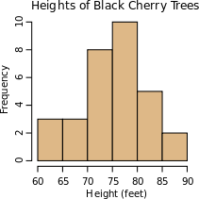
Why do we cluster?
Counting
Feature histograms: by grouping similar features and counting how many of each a data sample has
Summarizing data
Look at large amounts of data
– Represent a large continuous vector with the cluster number
Prediction
Data points in the same cluster may have the same labels
Ask a human to label the clusters
Slide credit: J. Hays, D. Hoiem

Slide 8

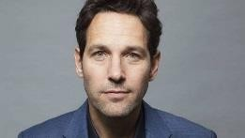
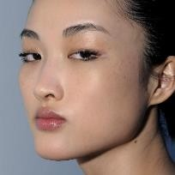
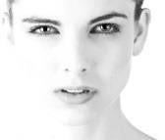

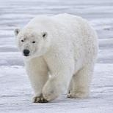
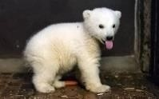
Unsupervised discovery

Slide 9
Clustering algorithms
In depth
K-means (iterate between finding centers and assigning points)
Gaussian Mixture Models (GMMs)

Slide 10

K-means Algorithm
Goal: represent a data set in terms of K clusters each of which is summarized by a prototype
Initialize prototypes, then iterate between two phases:
E-step: assign each data point to nearest prototype
M-step: update prototypes to be the cluster means
Simplest version is based on Euclidean distance
re-scale Old Faithful data

Slide 11
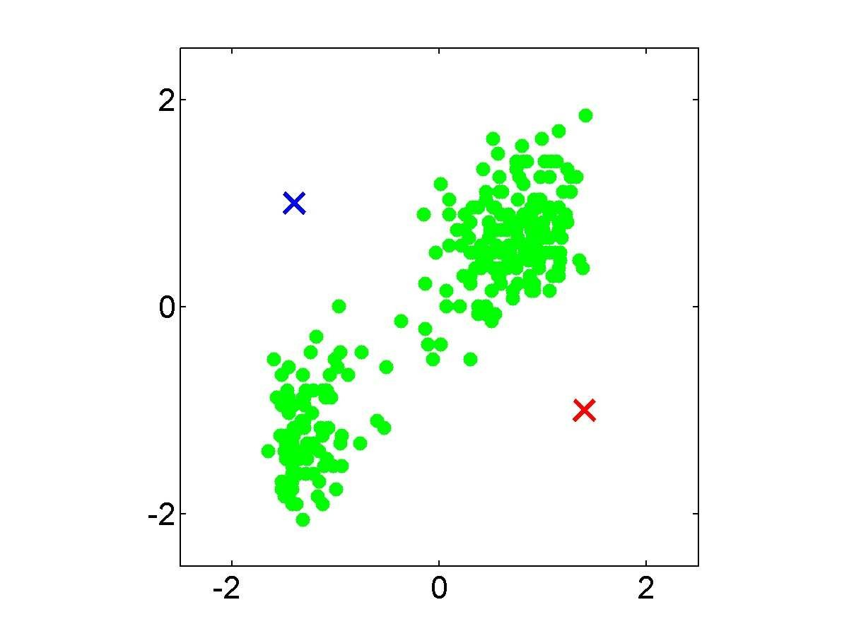
Example
Pick K random points as cluster centers (means)
Shown here for K=2

Slide 12
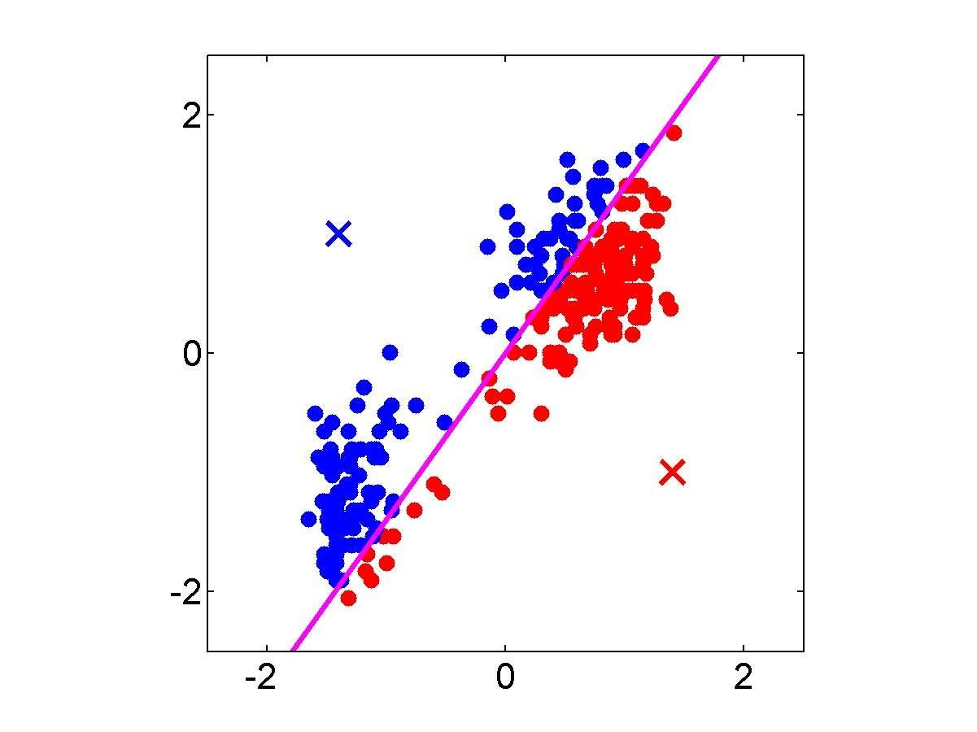
Iterative Step 1
Assign data points to closest
cluster center

Slide 13
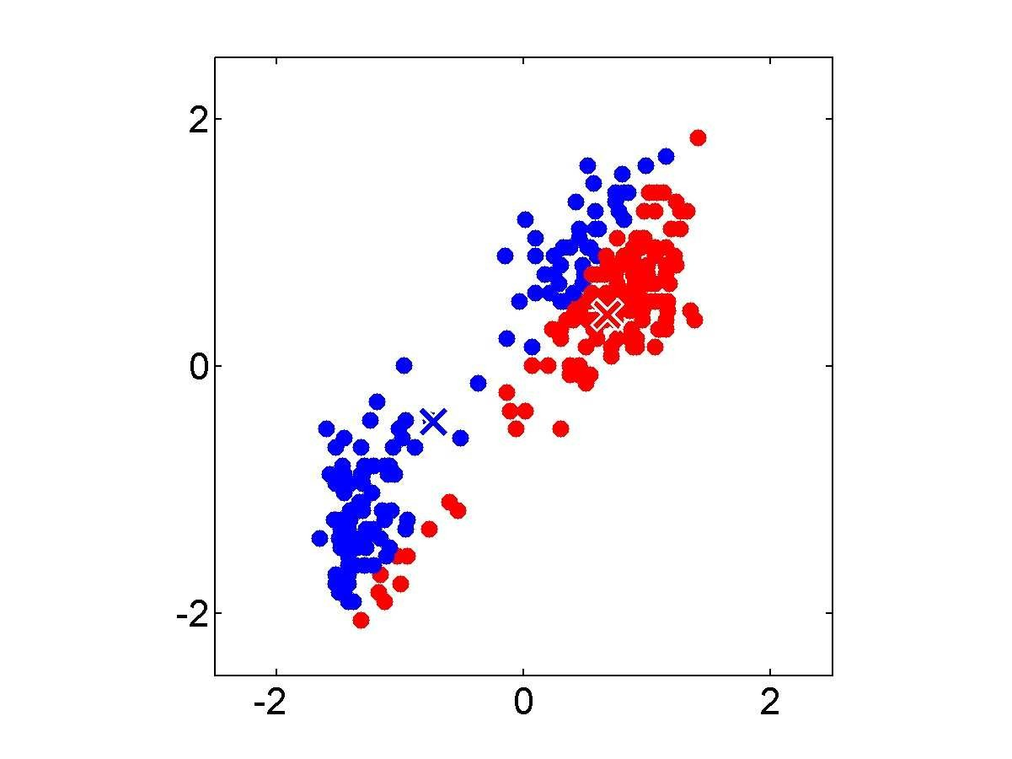
Iterative Step 2
Change the cluster center to the average of the assigned points

Slide 14
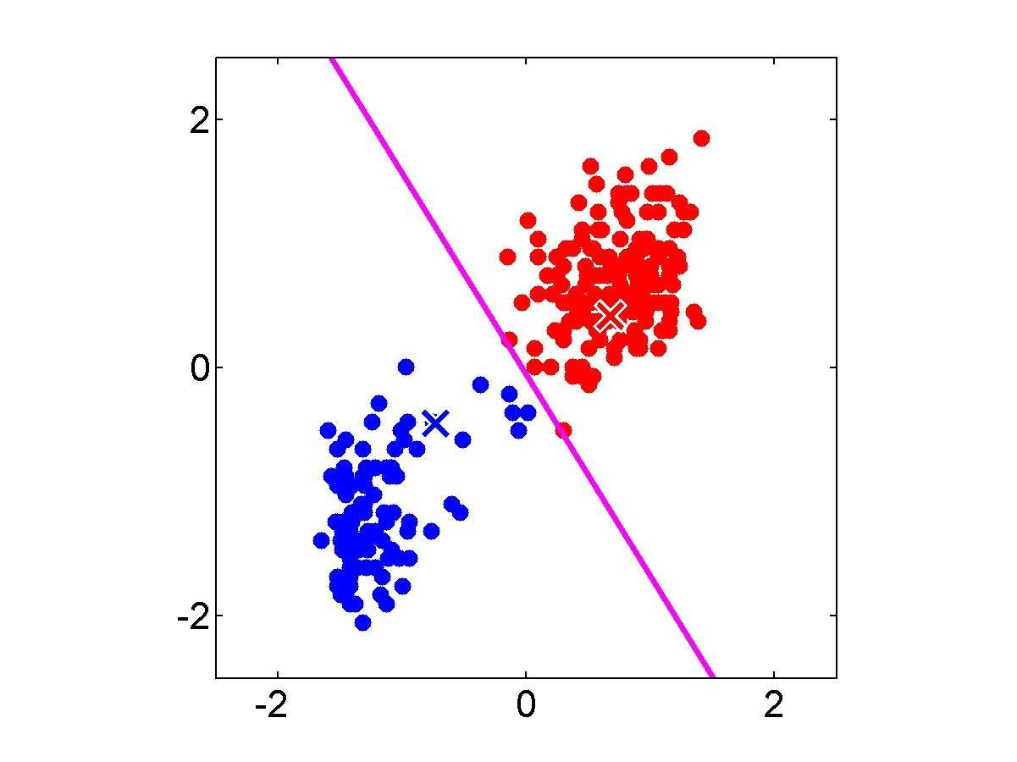
Repeat
until convergence

Slide 15


Slide 16
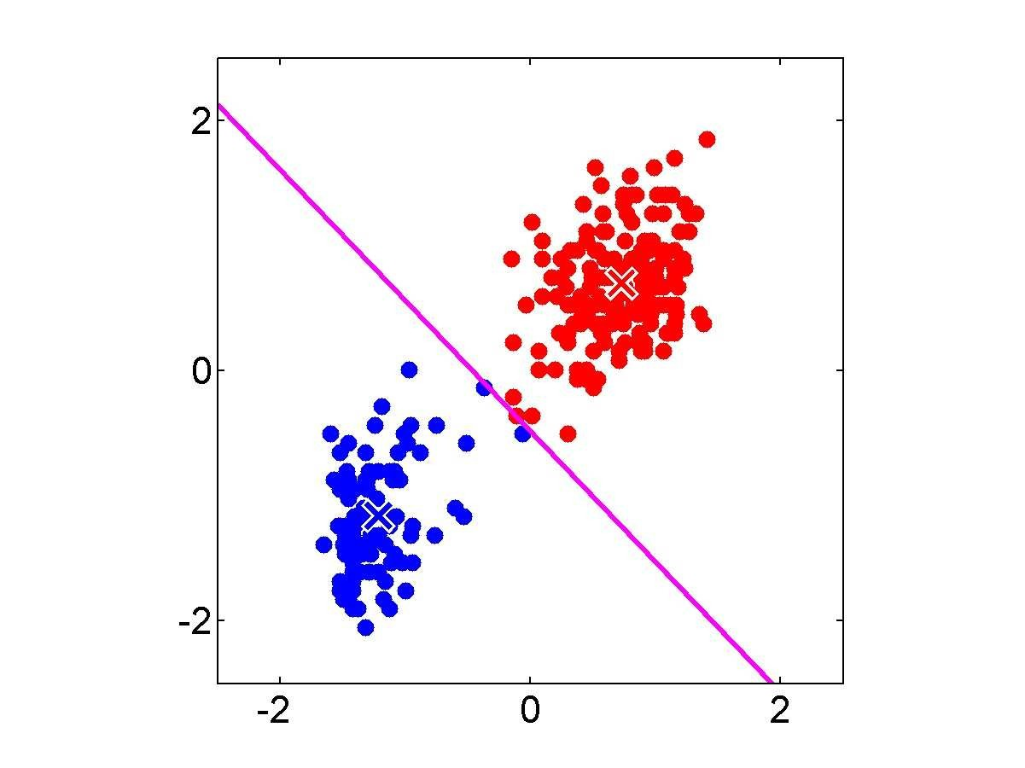

Slide 17


Slide 18


Slide 19


Slide 20
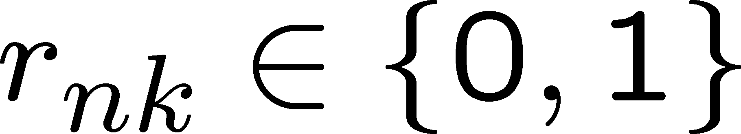
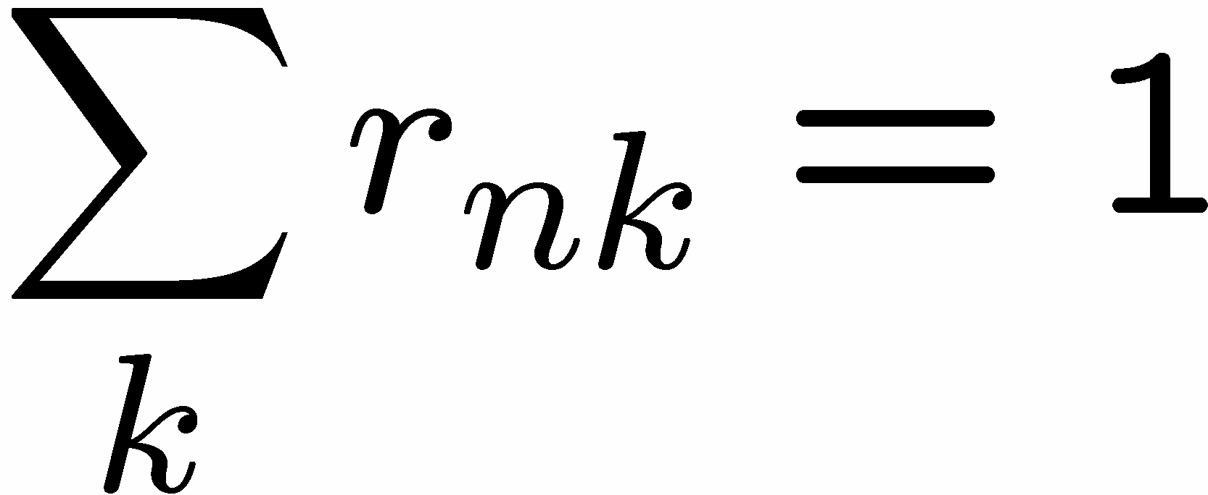
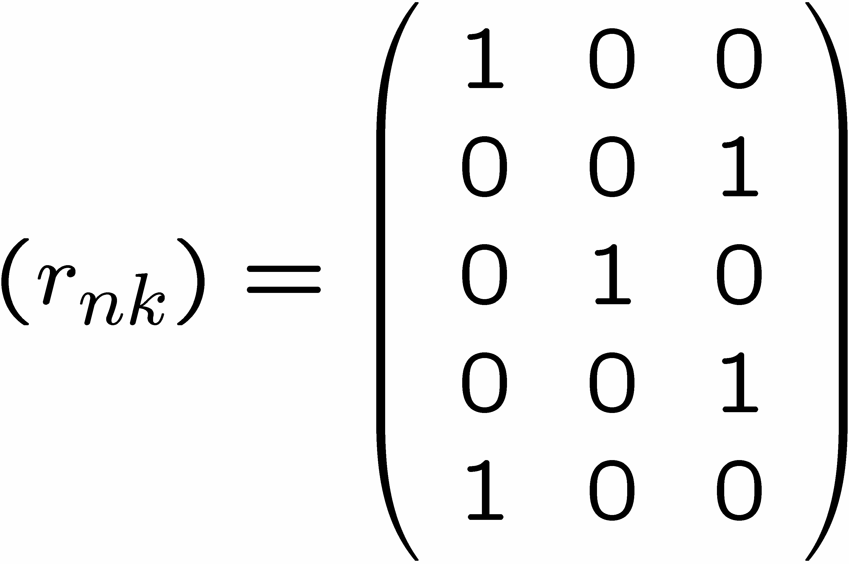
1 of K coding mechanism
For each data point x_{n}, we introduce a set of binary indicator variables
such that
where k =1,...,K describing which of the K clusters the data point x_{n} is assigned to, so that if data point x_{n} is assigned to cluster k then r_{nk} =1, and r_{nj} =0 for j not equal to k.
Example: 5 data points and 3 clusters

Slide 21
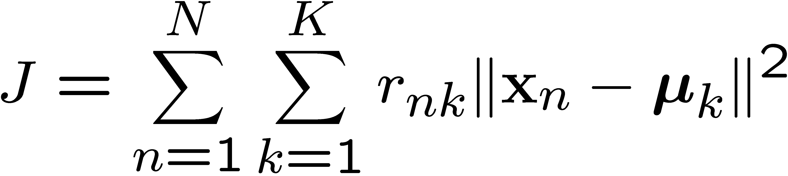
K-means Cost Function
data
responsibilities
prototypes

Slide 22
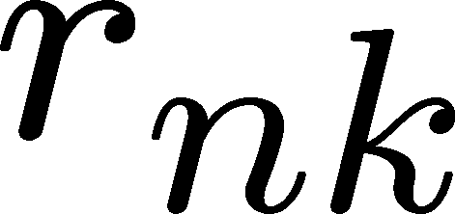
Minimizing the Cost Function
E-step: minimize J w.r.t.
M-step: minimize J w.r.t
Convergence guaranteed since there is a finite number of possible settings for the responsibilities

Slide 23
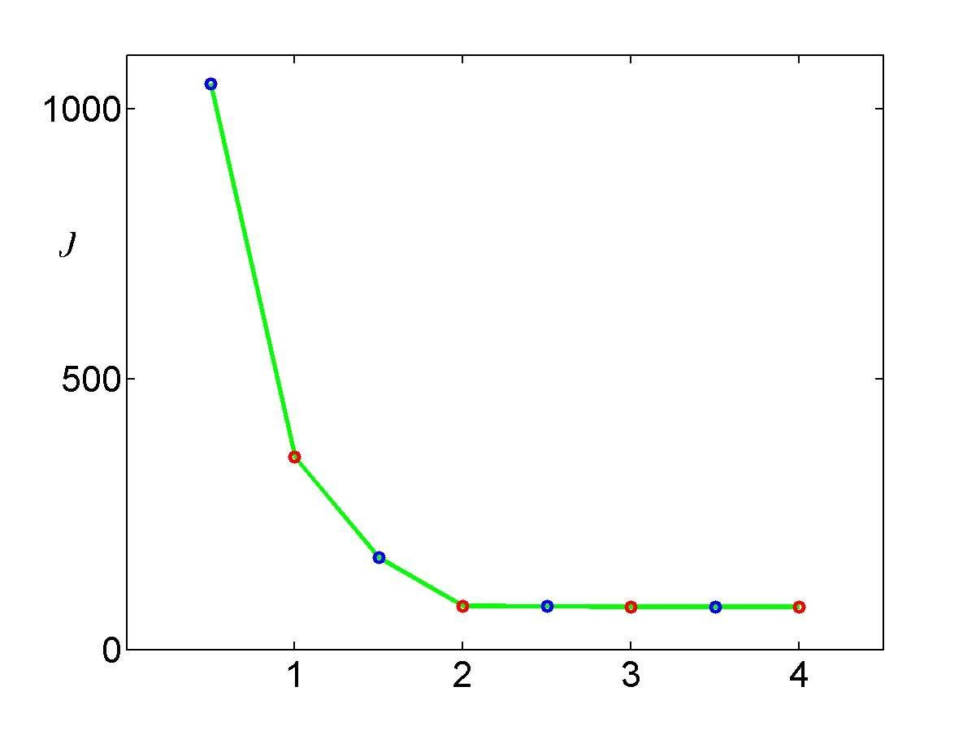
Convergence
Each E step (blue points) and M step (red points) . The algorithm has converged after the third M step, and the final EM cycle produces no changes in either the assignments or the prototype vectors.

Slide 24
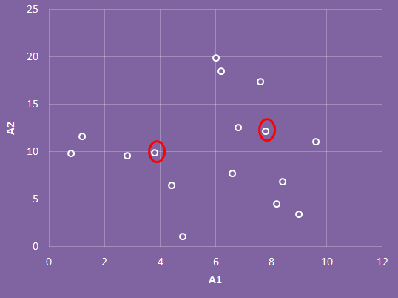
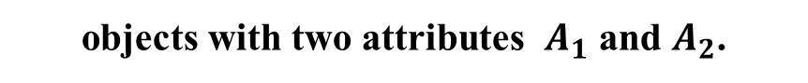
Example
A₁ | A₂
6.8 | 12.6
0.8 | 9.8
1.2 | 11.6
2.8 | 9.6
3.8 | 9.9
4.4 | 6.5
4.8 | 1.1
6.0 | 19.9
6.2 | 18.5
7.6 | 17.4
7.8 | 12.2
6.6 | 7.7
8.2 | 4.5
8.4 | 6.9
9.0 | 3.4
9.6 | 11.1
objects with two attributes $A_{1}$ and $A_{2}$.
k=3
Three objects are chosen at random
Adopted from Debasis Samanta

Slide 25
Example
Coordinates of 3 randomly chosen Centroids
Let d1, d2 and d3 : Euclidean distance to c1, c2 and c3 respectively..
Centroid
 | A1 | A2
c₁ | 3.8 | 9.9
c₂ | 7.8 | 12.2
c₃ | 6.2 | 18.5
Adopted from Debasis Samanta

Slide 26
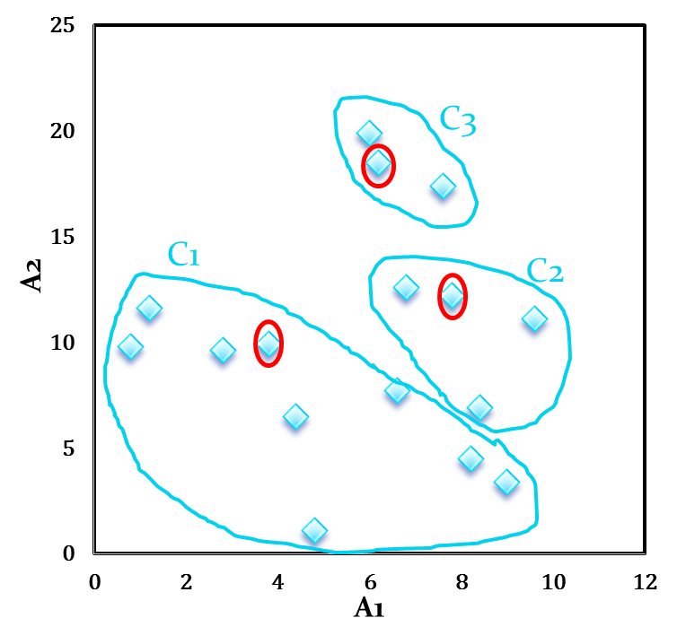
Example
A₁ | A₂ | d₁ | d₂ | d₃ | _{cluster}
6.8 | 12.6 | 4.0 | 1.1 | 5.9 | 2
0.8 | 9.8 | 3.0 | 7.4 | 10.2 | 1
1.2 | 11.6 | 3.1 | 6.6 | 8.5 | 1
2.8 | 9.6 | 1.0 | 5.6 | 9.5 | 1
3.8 | 9.9 | 0.0 | 4.6 | 8.9 | 1
4.4 | 6.5 | 3.5 | 6.6 | 12.1 | 1
4.8 | 1.1 | 8.9 | 11.5 | 17.5 | 1
6.0 | 19.9 | 10.2 | 7.9 | 1.4 | 3
6.2 | 18.5 | 8.9 | 6.5 | 0.0 | 3
7.6 | 17.4 | 8.4 | 5.2 | 1.8 | 3
7.8 | 12.2 | 4.6 | 0.0 | 6.5 | 2
6.6 | 7.7 | 3.6 | 4.7 | 10.8 | 1
8.2 | 4.5 | 7.0 | 7.7 | 14.1 | 1
8.4 | 6.9 | 5.5 | 5.3 | 11.8 | 2
9.0 | 3.4 | 8.3 | 8.9 | 15.4 | 1
9.6 | 11.1 | 5.9 | 2.1 | 8.1 | 2
Adopted from Debasis Samanta

Slide 27
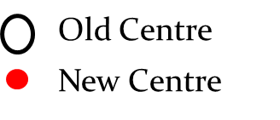
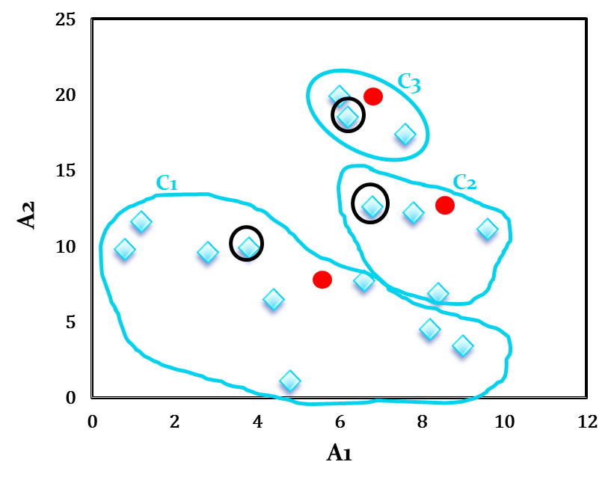
Example
Initial cluster with new centroids
new centroids
New Centroid | Revised Centroids
 | A1 | A2
c₁ | 4.6 | 7.1
c₂ | 8.2 | 10.7
c₃ | 6.6 | 18.6
Adopted from Debasis Samanta

Slide 28
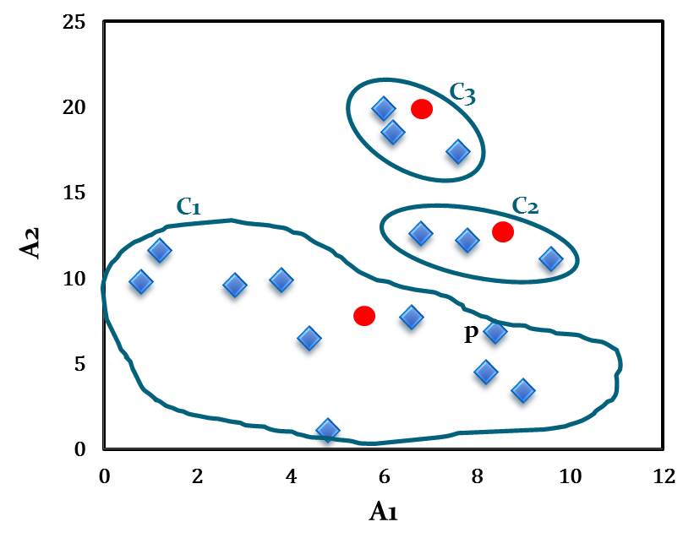
Illustration of k-Means clustering algorithms
reassign the 16 data points
Note that point p moves from cluster C2 to cluster C1.
Cluster after first iteration
Adopted from Debasis Samanta

Slide 29
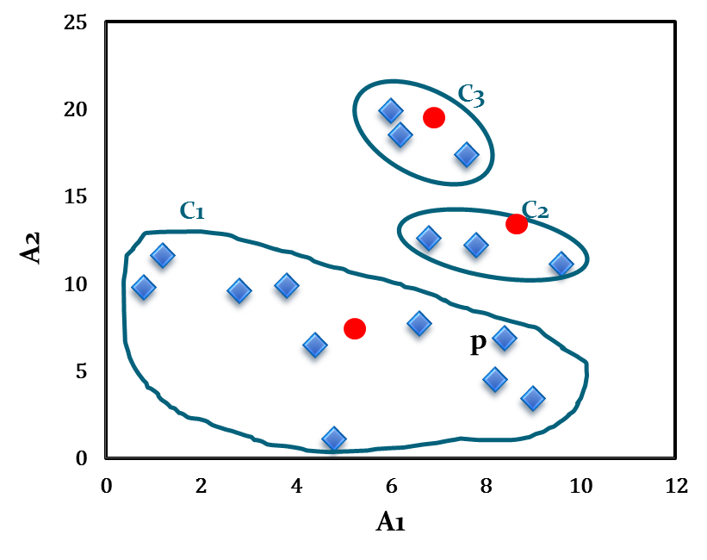
Illustration of k-Means clustering algorithms
Cluster centres after second iteration
Cluster after Second iteration
Centroid | Revised Centroids
 | A1 | A2
c₁ | 5.0 | 7.1
c₂ | 8.1 | 12.0
c₃ | 6.6 | 18.6
Adopted from Debasis Samanta

Slide 30
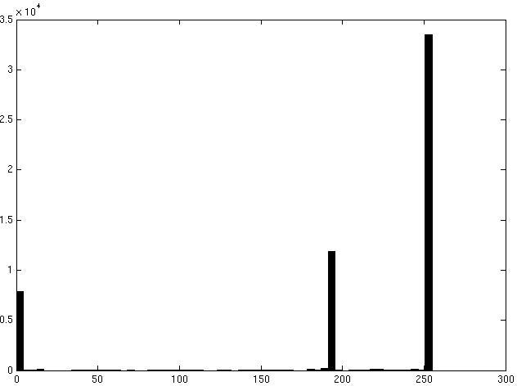

Image segmentation: toy example
white pixels
3
pixel count
black pixels
gray
pixels
1
2
input image
intensity
These intensities define the three groups.
We could label every pixel in the image according to which of these primary intensities it is.
i.e., segment the image based on the intensity feature.
What if the image isn’t quite so simple?
Source: K. Grauman

Slide 31
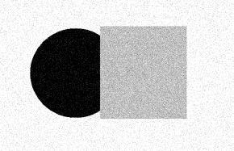
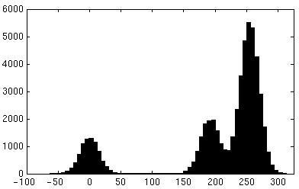
Now how to determine the three main intensities that define our groups?
We need to cluster.
input image
intensity
pixel count
pixel count
input image
intensity
Source: K. Grauman

Slide 32

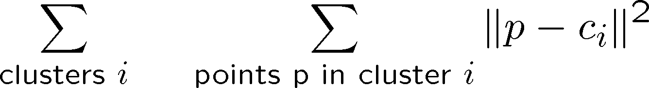
0
190
intensity
255
3
1
2
Goal: choose three “centers” as the representative intensities, and label every pixel according to which of these centers it is nearest to.
Best cluster centers are those that minimize SSD between all points and their nearest cluster center c_{i}:
Source: K. Grauman

Slide 33
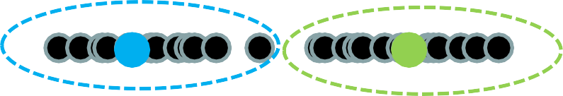
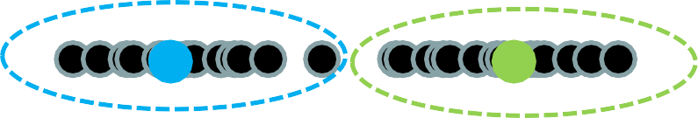

Clustering
With this objective, it is a “chicken and egg” problem:
– If we knew the cluster centers, we could allocate points to groups by assigning each to its closest center.
– If we knew the group memberships, we could get the centers by computing the mean per group.
Source: K. Grauman

Slide 34
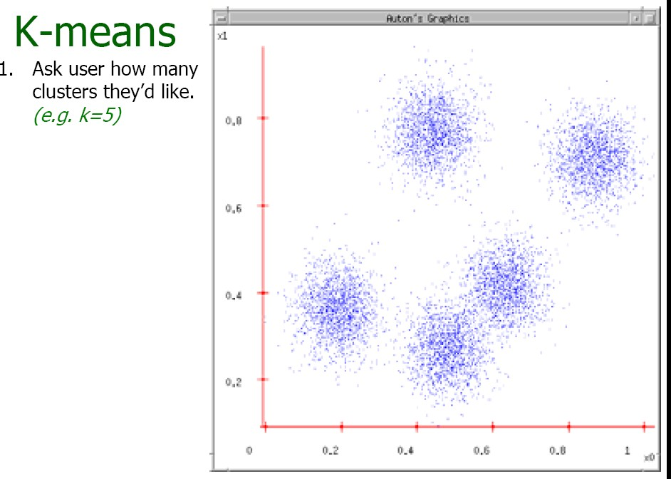
Source: A. Moore

Slide 35
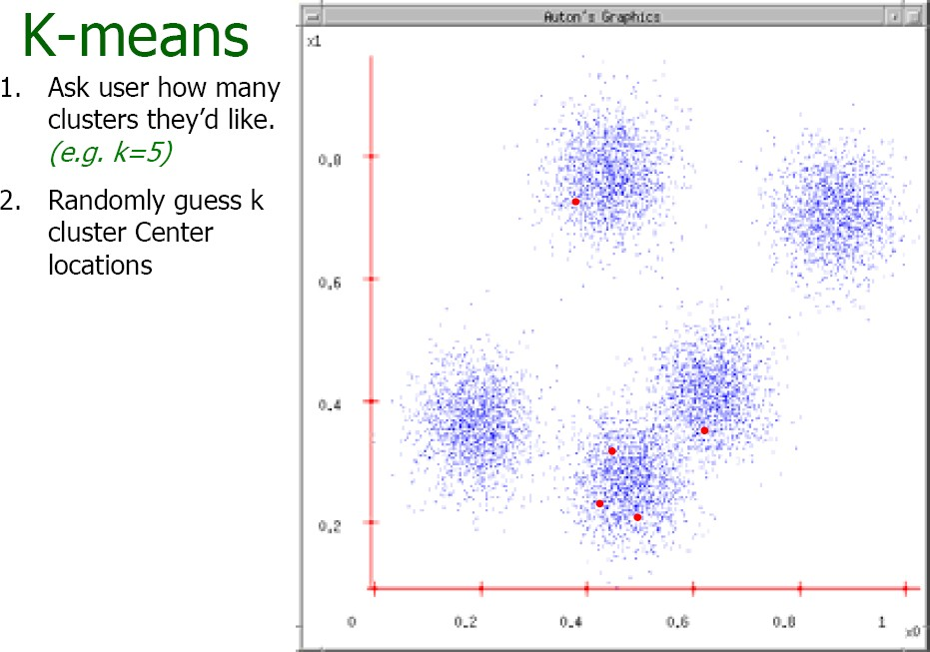
Source: A. Moore

Slide 36
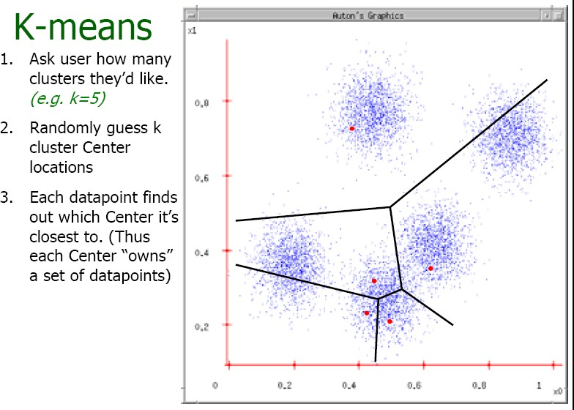
Source: A. Moore

Slide 37
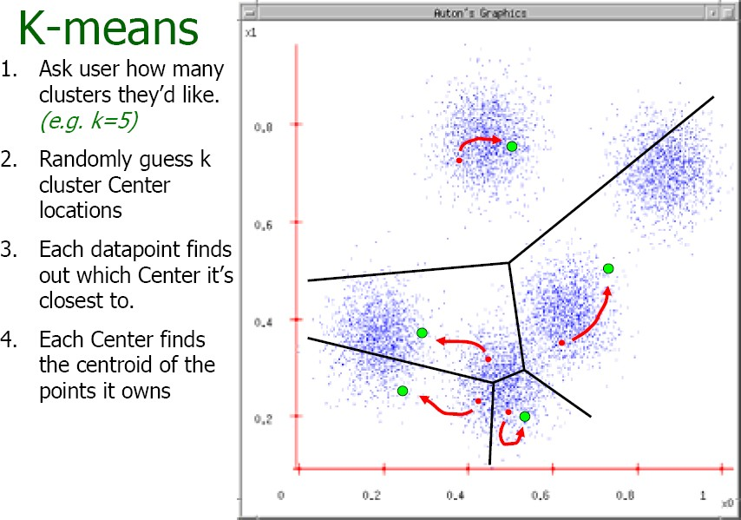
Source: A. Moore

Slide 38
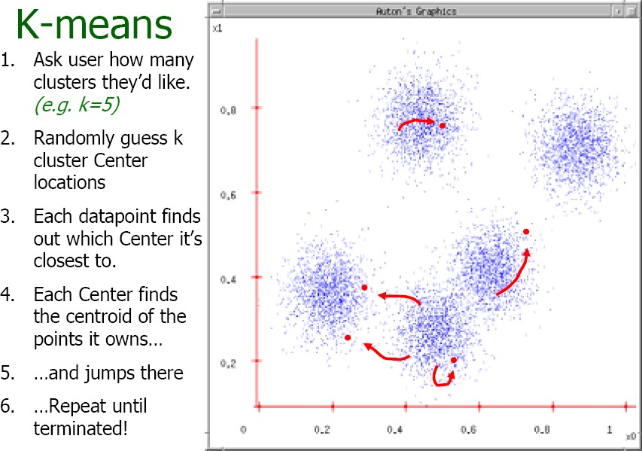
Source: A. Moore

Slide 39
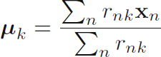
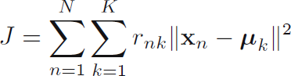
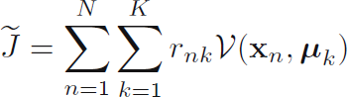
Another way of writing objective
K-means:
Let r_{nk} = 1 if instance n belongs to cluster k, 0 otherwise
k-means the centre of a cluster is not necessarily one of the input data points (it is the average between the points in the cluster).
K-medoids (more general distances):
k-medoids chooses data points as centers (medoids or exemplars) and can be used with arbitrary distances
k-medoids more robust to noise and outliers as compared to k-means because it minimizes a sum of pairwise dissimilarities instead of a sum of squared Euclidean distances.

Slide 40
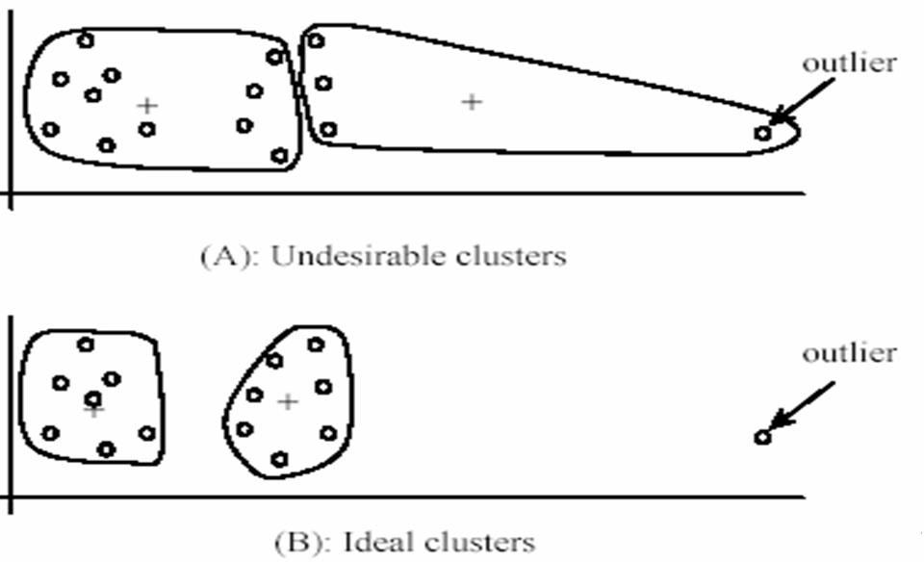
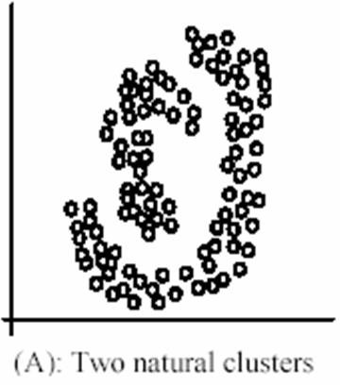
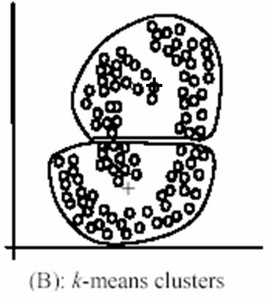
K-means: pros and cons
Pros
Simple, fast to compute
Converges to local minimum of
within-cluster squared error
Cons/issues
Setting k?
Sensitive to initial centers
Use heuristics or output of another method
Sensitive to outliers
Detects spherical clusters
Adapted from K. Grauman

Slide 41
Limitations of K-means
Hard assignments of data points to clusters – small shift of a data point can flip it to a different cluster
Not clear how to choose the value of K
Solution: replace ‘hard’ clustering of K-means with ‘soft’ probabilistic assignments
Represents the probability distribution of the data as a Gaussian mixture model

Slide 42
Probabilistic Clustering
Represent the probability distribution of
the data as a mixture model
captures uncertainty in cluster assignments
gives model for data distribution
Bayesian mixture model allows us to determine K
Consider mixtures of Gaussians

Slide 43
Mixtures of Gaussians
K-means algorithm
Assigned each example to exactly one cluster
What if clusters are overlapping?
Hard to tell which cluster is right
Maybe we should try to remain uncertain
Used Euclidean distance
What if cluster has a non-circular shape?
Gaussian mixture models
Clusters modeled as Gaussians
Not just by their mean
EM algorithm: assign data to cluster with some probability
Slide Credit: Alexander Ihler

Slide 44
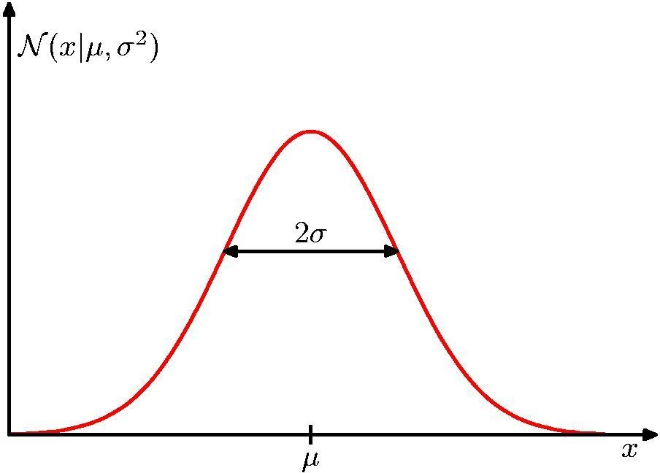
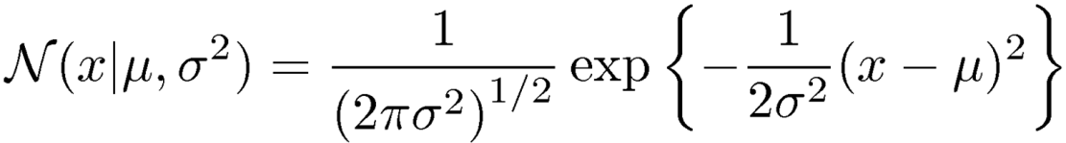
Review: Gaussian Distribution
Chris Bishop

Slide 45
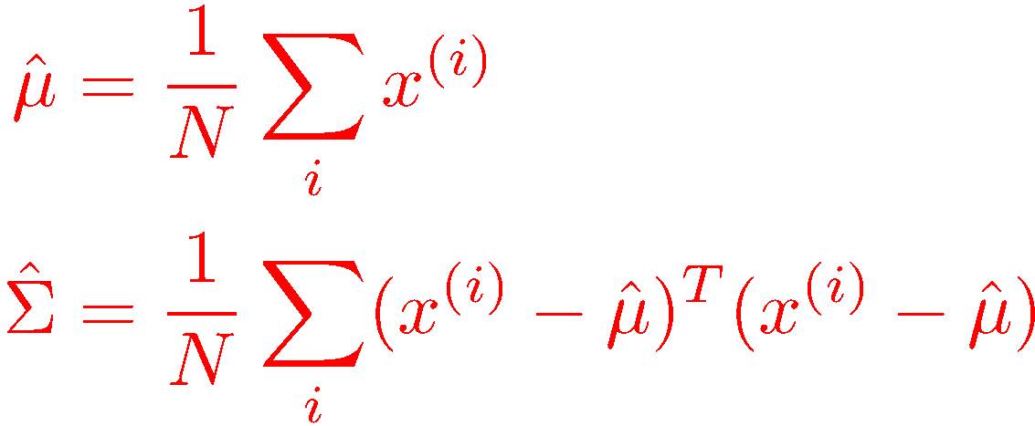
Multivariate Gaussian models
5
Maximum Likelihood estimates
4
3
2
1
0
We’ll model each cluster using one of these Gaussian “bells”…
-1
-2
-2
-1
0
1
2
3
4
5
Slide Credit: Alexander Ihler

Slide 46
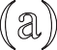


Review: Gaussian Distribution
Multivariate Gaussian
mean
covariance
x
2
x
2
x
2
x
1
x
1
x
1
(a)
(b)
(c)

Slide 47
Example: Mixture of 3 Gaussians
1
0.5
0
0
0.5
1
(a)

Slide 48
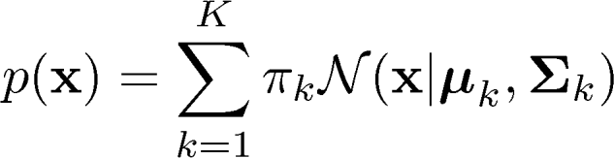
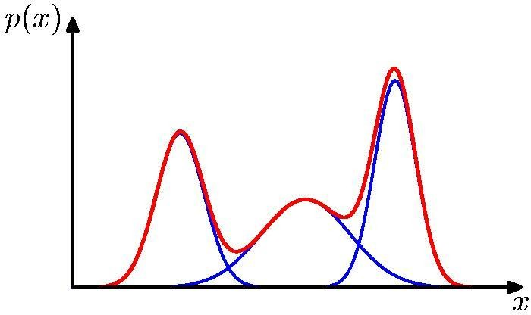
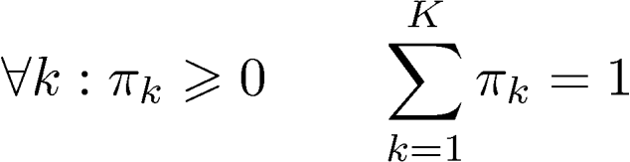
Mixtures of Gaussians
Consider a superposition of K Gaussian densities of the form
K=3
Component Mixing coefficient
Normalization and positivity require
Each Gaussian density N(x|μk,Σk) is called a component of the mixture and has its own mean μ_{k} and covariance Σ_{k}
Adapted from Chris Bishop

Slide 49
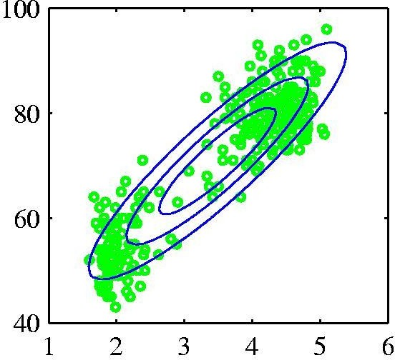
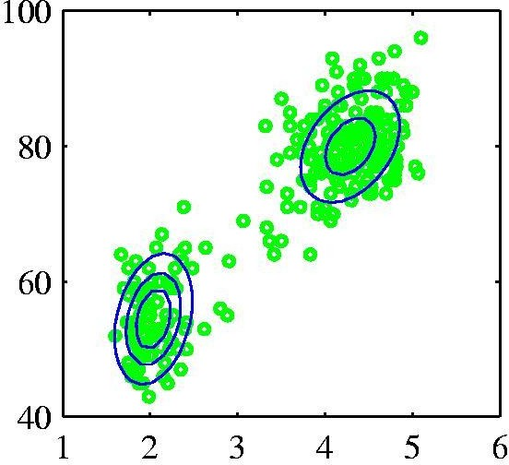
Probabilistic version: Mixtures of Gaussians
Old Faithful data set
Single Gaussian
Mixture of two
Gaussians
Chris Bishop

Slide 50

Mixtures of Gaussians
https://towardsdatascience.com/gaussian-mixture-models-explained-6986aaf5a95

Slide 51





Latent Variables Z
Introduce new binary random variable $Z_{i}$ for each $X_{i}$
Latent / hidden: not observed in the data
Given a data point x, what is the probability it came from Gaussian k
K-dimensional binary random variable z having a 1-of-K representation in which a particular element z_{k} is equal to 1 and all other elements are equal to 0.
The values of z_{k} therefore satisfy z_{k} ∈{ 0,1}
$$Z_{i}$$
$$X_{i}$$
$$N$$

Slide 52

GMM Model
p(z) : marginal distribution
what is the likelihood that the i^{th} sample came from Gaussian k.
p(z_{k} = 1) = π_{k}
z uses a 1-of-K representation, we can also write this distribution in the form

Slide 53

GMM Model
p(x|z) : Conditional distribution of x given a particular value for z is a Gaussian
p(x|z_{k} = 1) = N(x|μ_{k},Σ_{k})
z uses a 1-of-K representation, we can also write this distribution in the form

Slide 54

GMM Model
we can view π_{k} = p(z_{k}) as the prior probability of picking the kth component,
density N(x|μ_{k},Σ_{k}) = p(x|z_{k}) as the probability of x conditioned on k
we have represented the marginal distribution in the form
p(x) = _{z}p(x, z)

Slide 55

GMM Model
p(z_{k} =1 | x) = γ(z_{k}) = Conditional probability of z given x
using Bayes’ theorem
π_{k} : prior probability of z_{k} =1,
γ(z_{k}) : posterior probability once we have observed x also called responsibilities
γ​(z_{k})​ is the probability that x_{i}​ is generated by component Z_{k}.

Slide 56

Maximum Likelihood
Log of likelihood function:
Maximizing the log likelihood function for a Gaussian mixture model turns out to be a more complex problem than for the case of a single Gaussian.
The difﬁculty arises from the presence of the summation over k that appears inside the logarithm, so that the logarithm function no longer acts directly on the Gaussian.

Slide 57

EM algorithm for GMM
Initialize the means µ_{k}, covariances Σ_{k} and mixing coefﬁcients π_{k}, and evaluate the initial value of the log likelihood.
E step: Evaluate the responsibilities (posterior probabilities) using the current parameter

Slide 58


EM algorithm for GMM
3. M step: Re-estimate the parameters using the current responsibilities, N_{k} as the effective number of points assigned to cluster k.
Weighted mean of assigned data
Weighted covariance of assigned data
where
π_{k} = Fraction of total assigned to cluster k
N_{k} = Total responsibility allocated to cluster k
differentiating the log likelihood to µ_{k}, Σ_{k}
Setting derivative with respect equal to zero
For mixing coefficients use a Lagrange multiplier

Slide 59

EM algorithm for GMM
4.Evaluate the log likelihood: converged when the parameters falls below some threshold

Slide 60

Gaussian Mixture Example: Start

Slide 61

After first iteration
Slide Credit: Andrew W. Moore

Slide 62

After 2nd iteration
Slide Credit: Andrew W. Moore

Slide 63

After 3rd iteration
Slide Credit: Andrew W. Moore

Slide 64

After 4th iteration
Slide Credit: Andrew W. Moore

Slide 65

After 5th iteration
Slide Credit: Andrew W. Moore

Slide 66

After 6th iteration
Slide Credit: Andrew W. Moore

Slide 67

After 20th iteration
Slide Credit: Andrew W. Moore

Slide 68

Segmentation as clustering
Depending on what we choose as the feature space, we
can group pixels in different ways.
Grouping pixels based on intensity similarity
Feature space: intensity value (1d)
Source: K. Grauman

Slide 69


K=2
K=3
quantization of the feature space; segmentation label map
Source: K. Grauman

Slide 70





Segmentation as clustering
Depending on what we choose as the feature space, we
can group pixels in different ways.
R=255
Grouping pixels based on color similarity
G=200 B=250
B
R=245 G=220 B=248
G
R=15 G=189 B=2
R=3 G=12 B=2
R
Feature space: color value (3-d)
Source: K. Grauman

Slide 71
References
Christopher Bishop: Pattern Recognition and Machine Learning, Springer International Edition
https://www.youtube.com/watch?v=TG6Bh-NFhA0
https://www.youtube.com/watch?v=qMTuMa86NzU

